Slide 1
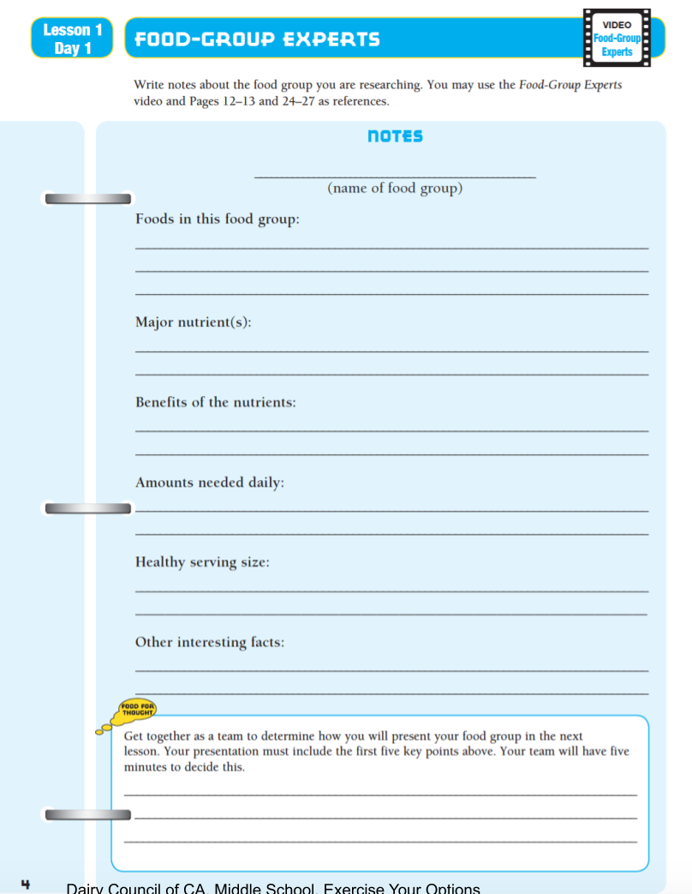

Slide 2
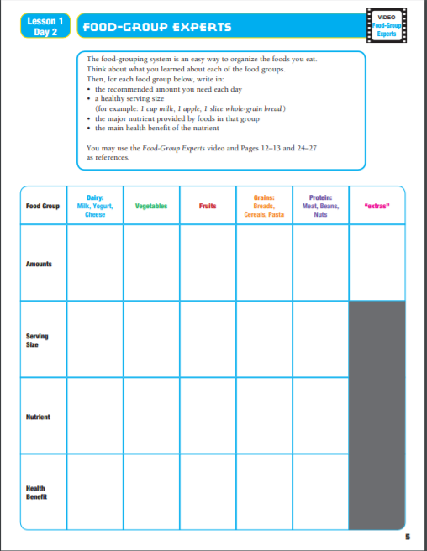
The food-grouping system is an easy way to organize the food you eat.
Think about what you learned about each of the food groups.
Then, for each food group below, write in:
The recommended amount you need each day.
A healthy serving size
(for example, 1 cup milk, 1 apple, 1 slice whole-grain bread”
The major nutrient provided by foods in that group
The main health benefit of the nutrient
You may use the Food-Group Experts video and pages 12-13 and 24-27 as references.
Food Group
Dairy:
Milk, Yogurt, Cheese
Vegetables
Fruits
Grains:
Breads,
Cereals, Pasta
Protein:
Meat, Beans, Nuts
“Extras”
Amounts
Serving Size
Nutrient
Health Benefit
California Dairy Council

Slide 3
